Slide 2
Read construction
Unique ind. barcode
Sequence of interest
Illumina adapter
Restriction site

Slide 3
Read construction
Unique ind. barcode
Sequence of interest
Illumina adapter
Restriction site

Slide 4
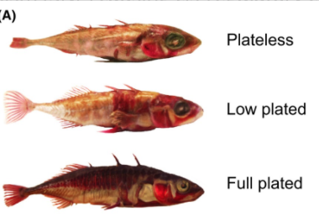
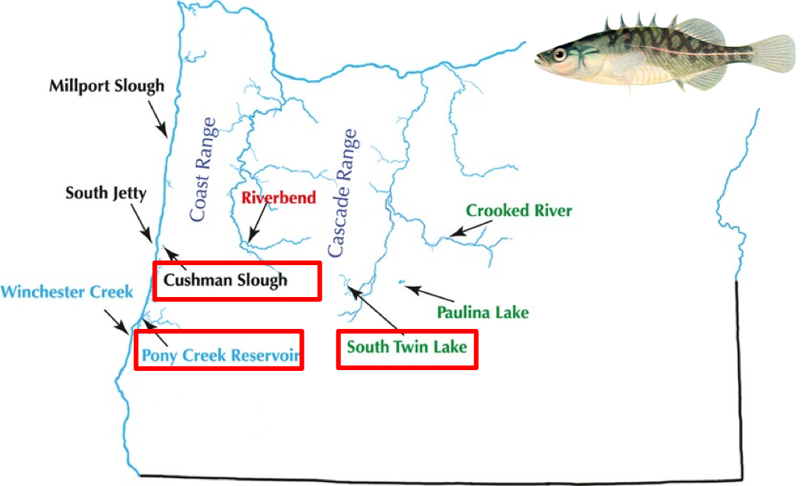
Mazzarella et al. 2016
Catchen et al 2013

Slide 5
Denovo pipeline
USTACKS
Build loci de novo
Pipel
ine
CSTACKS
Assemble catalog
SSTACKS
Match to catalog
Populations
Filter loci and compute
Population statistics

Slide 7
Parameter Description | denovo_map.pl Parameter | Pipeline component | Component Parameter | Default Value
Minimum stack depth / minimum depth of coverage | -m | ustacks | -m | 3
Distance allowed between stacks | -M | ustacks | -M | 2
Distance allowed between catalog loci | -n | cstacks | -n | 1
“If –M is too low, you start separating variants of a single gene as different genes. If you set them too high, you start merging paralogs.”

Slide 8
We will find collectively
the parameters that find
the most new loci at r 0.8
Paris et al. 2017

Slide 9
reference pipeline
USTACKS
Build loci de novo
Pipel
ine
CSTACKS
Assemble catalog
SSTACKS
Match to catalog
Populations
Filter loci and compute
Population statistics

Slide 10
Reference pipeline
Pipel
ine
Alignment to a reference genome
Populations
Filter loci and compute
Population statistics

